Slide 1
Responding to the wellbeing and safety of children
Community education pack
Notes:
Version control:
C&F and FSV reviewed and endorsed Jan 2024

Slide 2
Acknowledgement of country
The Department acknowledges the Traditional Owners of Country throughout Victoria and pays respects to their Elders past and present.
The Department also acknowledges that Aboriginal self-determination is a human right and recognises the hard work of many generations of Aboriginal people who have fought for this right to be upheld.

Slide 3
Welcome, introductions and key messages
Supporting and protecting children is everyone's responsibility
In Victoria there are universal, secondary, specialist and tertiary services that support children and families
Knowing the right service to contact about concerns for a child is a key part of your role in supporting children and families in our community
The Orange Door network is the statewide intake and assessment service in each DFFH area for people who are impacted by family violence, as well as families needing support with the wellbeing of their children and young people (including unborn children).
Child Protection receives reports for children, including unborn children, who may be in need of protection AND parents have not protected or are unlikely to protect their child

Slide 4
Agenda for today
Victoria’s approach to supporting children and families
Child wellbeing and child safety
The Orange Door and its role
Child Protection and its role
Progressing Aboriginal self-determination
Mandatory reporting and other reporting requirements
Family violence and MARAM
Information Sharing

Slide 5
Victoria’s approach to supporting children and families

Slide 6
Victoria's service continuum
Child Protection
ACAC
Police
Care Services
The Orange Door | ACCOs
Parent Services | Family Services
Drug & Alcohol Services
Mental Health Services
Early Intervention Services
Specialist Children’s Services
Family Violence & Sexual Assault Services
School Focussed Youth Services
Childcare
Preschools
Maternal & Child Health
Neighbourhood Houses
Telephone counselling
GPs | Schools
Community Health Centres
Tertiary Services
Protecting children is everyone’s responsibility
Secondary Services
Universal Services

Slide 7
The Orange Door network

Slide 8
About The Orange Door network
The Orange Door network is the statewide intake and assessment service in each DFFH area for families needing support with the wellbeing of their children and young people as well as people who are impacted by family violence.
The Orange Door network also engages with people who use family violence to respond to the risk they pose and connect them with services to address their behaviour.
The Orange Door network draws on the expertise of an inter-disciplinary team via community service organisations (family violence, family services and aboriginal services) to work with people and families to assess their risk and needs. Community Based Child Protection works in each Orange Door to provide advice relating to children and young people’s risk.
The Orange Door aims to ensure there is no wrong door to accessing high quality, consistent and effective support.
Following assessment and planning by The Orange Door, children, young people, families and adults are given comprehensive, tailored advice about supports and services that are available to assist each individual. People are then supported to connect with the assistance they choose.

Slide 9
The Orange Door response
The Orange Door provides:
screening via information gathering
identification of primary needs
triage for urgency and priority
secondary consultations, including to schools/healthcare providers/third parties, to provide valuable family violence expertise and support to assess and manage family violence risk and child and young person wellbeing.
The Orange Door response includes (as required):
crisis responses including brokerage
risk and wellbeing assessment and management (including safety planning)
needs assessment
service planning
referral to family services, Aboriginal Community Controlled Organisations, family violence services and/or broader services
active engagement for people and families awaiting a service response.

Slide 10
Client journey through The Orange Door network
The Orange Door creates a clear intake and assessment point for people to get help.
Access Screening, identification and triage Service responses Connection to services
& Assessment and planning
Children, young people, families and professionals can approach The Orange Door directly:
by phone
online
visiting a physical site
Engagement with an Orange Door outreach worker they feel safe and comfortable.
Children, young people and families will have their risk and needs assessed. Where there is risk to the child or young person The Orange Door may consult with Community Based Child Protection to determine the best approach.
Responses provided by The Orange Door include:
brief interventions,
brokerage
safety planning
crisis responses.
Children, young people and families are given comprehensive advice about supports and services that are available. They are supported to connect with the services they choose.
Child and young person wellbeing referrals
Children, young people and families receive a coordinated service system
response
Direct contact
Family violence referrals
Other professional referrals such as Health services.

Slide 11
Wellbeing concerns: key information
You can contact The Orange Door network when you have wellbeing concerns for a child or young person
Examples of wellbeing concerns include:
parenting problems that may be affecting the child’s development​
family violence, including family breakdown​
families under pressure due to a family member’s physical or mental illness, substance misuse, disability or bereavement​
isolated or unsupported families​
significant social or economic disadvantage that may adversely impact on a child’s care or development.​
For further information see:
Making a referral to The Orange Door - DFFH Service Providers [https://providers.dffh.vic.gov.au/making-referral-orange-door]
Key Information
The Orange Door network is a free service
It is open 9 am to 5 pm Monday to Friday (closed public holidays)
The Orange Door network is accessible by phone, email or people can attend in person.
People can self-refer.
Professionals and community members can refer families and individuals.
Anyone can call for advice
The Orange Door is an intake and assessment service, designed to streamline the client journey into longer term responses.
Website: [https://www.orangedoor.vic.gov.au/]

Slide 12
Child Protection

Slide 13
Child Protection in Victoria
Child Protection is delivered across 17 DFFH areas within Victoria, with Statewide intake and after-hours services
Reports can be made to Child Protection Intake Monday to Friday during business hours
For urgent reports outside of business hours, weekends and public holidays, these can be made to after-hours service.
Aboriginal Children in Aboriginal Care (ACAC) began as a program for Aboriginal children subject to a Children's Court protection order. Section 18 of the Children, Youth and Families Act 2005 enables the Secretary to authorise the principal officer of an Aboriginal agency to undertake specific functions and powers in relation to a Children's Court protection order for an Aboriginal child or young person.
The Victorian Aboriginal Child Care Agency (VACCA) Nugel program was authorised in 2017, Bendigo District and Aboriginal Cooperative (BDAC) Mutjang Bupuwingarrak Mukman program was authorised in 2018 and Ballarat and District Aboriginal Cooperative (BADAC) Gobata Burron was authorised in August 2023.
The Community Protecting Boorais commenced in September 2023 with VACCA and BDAC also being authroised to undertake child protection investigations.
**Further details about ACAC and Community Protecting Boorais is provided later in the presentation**

Slide 14
What are the core responsibilities of Child Protection?
Child Protection:
Receives reports for children and young people under 17 ​years (and 18 years for existing clients)
where a child may be in need of protection AND parents have not protected or are unlikely to protect their child​ OR
there are significant concern for a child’s wellbeing or unborn child
Receives reports for children aged between 10 to 18 years who exhibit sexually abusive behaviours and in need of therapeutic treatment​
Investigates reports classified as protective intervention reports
Assesses risk of harm
Develops case plans where harm has been substantiated
Refers families to support services​
Applies for protection orders from the Children’s Court​
Supervises children on protection orders until the order expires or their 18th birthday or until they marry

Slide 15
Child Protection process
Report to Child Protection
Intake
The Orange Door
Aboriginal Child Specialist Advice and Support Service (ACSASS)
Aboriginal Children in Care (ACAC)
Investigation
Protective Intervention
Protection Order
Closure

Slide 16
When is a child in need of protection?
Section 162 of the CYFA 2005 provides the definition of when a child is in need of protection:
The parents cannot be located, are dead or incapacitated and no other suitable person can be found​
The child has suffered or is likely to suffer significant​ physical harm, sexual abuse, emotional/psychological harm or neglect AND the child’s parents have not protected or are unlikely to protect the child​
The child is in need of therapeutic treatment for sexually abusive behaviours​
Harm may be constituted by a single act, omission or circumstance or accumulate through a series of continuing acts, omissions or circumstances

Slide 17
Legislation and Protective Orders
Children, Youth and Families Act 2005 (CYFA)
The Act applies to Child Protection, Community Based Child and Family Services, Children’s Court and Youth Justice
Best interests and decision-making principles guide practice for:
Children’s Court
Child Protection
Community service organisations
Aboriginal Community Controlled Organisations
The Court can make these orders if a child is need of protection:
Family Preservation Order​
Family Reunification Order ​
Care by Secretary Order ​
Long Term Care Order​
Permanent Care Order
The Court can also make these types of orders:
Undertaking​
Temporary Assessment Order​
Interim Accommodation Order​
Therapeutic Treatment Order or Therapeutic Treatment Placement Order
“…the best interests of the child must always be paramount”

Slide 18
Referral to The Orange Door network
or
Report to Child Protection?

Slide 19
A quick reference guide
Refer to The Orange Door network if:
You have:
concerns for the wellbeing of a child, but do not believe they are at risk of significant harm or in immediate need of protection OR
concerns for adults, children or young people who are experiencing family violence
Your concerns would be alleviated if services addressed:
parenting problems affecting a child’s wellbeing and development
family conflict or pressure adversely impacting a child’s care or development (e.g. due to physical or mental illness, substance misuse, bereavement, isolation etc)
Report to Child Protection if:
The child is in need of protection:
the child has been or is likely to be harmed
AND
the harm is significant in that it has or may jeopardise the child’s safety, wellbeing and development AND
the parents have not protected or unlikely to protect the child
You have formed a reasonable belief the harm has, or will occur
The child requires Child Protection statutory intervention to be safe
You do not need consent to get advice from or refer to The Orange Door network. You may wish to discuss your concerns with the family first to assist with the referral, as this is likely to increase willingness to engage with services.

Slide 20
Two distinct but interconnected pathways
The Orange Door network
18 sites in each DFFH Area
Child Protection Intake
State-wide Child Protection Intake Service and After-Hours Child Protection Service
State-wide entry point for integrated intake and assessment for family violence and child and young person wellbeing concerns (and unborn children)
PURPOSE
State-wide reports from professionals and public with significant concerns for children and young people’s safety (and unborn children)
Partner agencies (CSOs including Aboriginal services), government and community based CPP
WORKFORCE
Child Protection Practitioners (CPPs)
Anyone – professionals, families, public, self
Does not meet mandatory report requirements
Anyone – professionals, families, public, self
Mandatory reports (s184 CYFA) must come here
SOURCE
Need help with parenting, or worried about the wellbeing or development of a child or young person or safety of someone experiencing family violence
THRESHOLD
A child has suffered or is likely to suffer significant harm as a result of abuse and/or neglect, and their parent has not, or is unlikely to protect them
Assess to determine need for services and support and progress to services such as Family Services or where required report to Child Protection
OUTCOME
Assess to determine if meets threshold for further investigation and possible statutory intervention (protection). If not close with or without a referral for support services
Voluntary service – consent not required to make a referral, however consent is required to provide services and support
CONSENT
Consent not required to report or investigate

Slide 21
A helpful guide to identifying child abuse and neglect
Physical abuse
Possible physical indicators
bruises, burns, sprains, welts, dislocations, bite marks
fractured bones
poisoning
internal injuries
Possible behavioural indicators
showing wariness or distrust of adults
wearing long sleeved clothing on hot days (to hide bruising or other injury
demonstrating fear of parents and of going home
being very passive and compliant
Sexual abuse
Possible physical indicators
headaches, stomach aches
loss of appetite or weight loss
bed wetting, nightmares or sleep disturbances
bruising on soft parts of the body such as buttocks or thighs
Possible behavioural indicators
child telling someone that sexual abuse has occurred
displaying sexual behaviour or knowledge beyond child's age
poor self-care or personal hygiene
running away
anxiety-related illnesses – such as anorexia or bulimia
Neglect
Possible behavioural indicators
frequent hunger
poor hygiene
inappropriate clothing – e.g. wearing summer clothing in winter
left unsupervised for long periods of time
medical needs not attended to
Possible behavioural indicators
stealing food
often tired, falling asleep
developmental delays due to lack of stimulation
listless or immobile, emancipated and pale
poor or irregular attendance at a service – e.g. child care or school
Emotional abuse
Possible physical indicators
There are few physical indicators, although emotional abuse may cause delays in emotional, psychological, or even physical health development
Possible behaviour indicators
displaying low self-esteem
tending to be withdrawn, passive, tearful
displaying aggressive or demanding behaviour
being highly anxious

Slide 22
Examples: referring to The Orange Door network
Case study 1
Michael is 11 years old. He lives with his mother and two siblings aged 2 and 4 years. Concerns have been identified by Michael's teacher:
Michael’s attendance at school can be sporadic and he has not attended school in the last two weeks.
When he does attend school, he is often late, can be a bit 'smelly', looks tired and often doesn't have lunch.
Michael's mother, Michelle, says she is struggling with Michael's behaviour since he started seeing his father again. They are estranged.
Mother's speech at times sounded slurred and the teacher suspects the mother may be drinking alcohol (not confirmed)
Other parents have said they suspect that Michelle “likes to drink”
Case study 2
Jasmine is a 9 month old girl who resides in the care of her mother, Rose, and father, Sean, who are both first time parents. Concerns have been identified by the maternal and child health nurse:
The parents are young: Rose is 19 and Sean is 20 years of age.
Rose attended an appointment today and indicated Jasmine is not sleeping, both parents are tired and they are arguing. Sean is 'out partying' all the time and Rose presented as stressed.
Rose said she smoked marijuana this week because she needed something to calm her down. Rose said that she and Sean used to use marijuana regularly before Jasmine was born. No further details provided.
Jasmine is reported to be developing well. Meeting her milestones and gaining weight appropriately.

Slide 23
Examples: reporting to Child Protection
Case study 1
Destiny is 14 years old and has two younger siblings. She has attended school today and appears upset. Destiny approaches her teacher and discloses that:
She does not want to go home after school.
Last night she was late home from a friend's house and her father became angry.
When she tried to explain why she was late, her father refused to listen. He pushed her into the wall and screamed at her.
He always gets angry at Destiny and her mother is too scared to stop him as she doesn't want to get hit again.
He gets angry with her two younger brothers, and she is worried he will seriously hurt them.
He is really strict and punishes the three children by strapping them.
Destiny is concerned she will be punished when her father finds out she has spoken to her teacher
Case study 2
Bailey is 3 years old with developmental delay. He resides in the care of his parents in Office of Housing accommodation.
A housing worker attends the family home and observes:
The house is extremely cluttered and smelly. There are dirty dishes in the kitchen and loungeroom, and food scraps on the furniture and floor.
Bailey's room is sparsely furnished with a set of drawers and a porta-cot, which the parents explain is where he sleeps. The bedding is dirty and there is a distinct smell of urine.
Bailey is small and looks underweight. He cannot walk, is non-verbal and appears to have a linier bruises on his arm and leg
The parents advise that Bailey is not attending childcare and hasn't seen his paediatrician for about 12 months. They don't seem concerned about this.

Slide 24
Making a report to Child Protection

Slide 25
When reporting concerns for a child’s safety
When you have concerns for a child’s safety you can report to Child Protection if you have formed reasonable belief:
that a child is or may be in need of protection
the child has suffered significant harm or damage to their health or development
their parents have not protected and are unlikely to protect the child from harm of that type
statutory child protection intervention may be required to provide for the child’s safety
Examples of harm include:
physical injury, non-accidental or unexplained injury
Sexual abuse
emotional or psychological
neglect, poor care or lack of appropriate supervision
persistent family violence, parental substance misuse, psychiatric illness
Other reasons a child may be in need of protection:
a child’s actions or behaviour place them at risk sexual abuse
a child exhibiting sexually abusive behaviours and refusing therapeutic treatment
a child appears abandoned, child’s parents are dead or incapacitated and no other suitable person is willing and able to care for the child
where a child’s actions or behaviour may place them at risk of significant harm and the parents are unwilling or unable to protect the child

Slide 26
If a child makes a disclosure about abuse:
Do…..
Listen to the child without interrupting
Give support by demonstrating that you believe their story
Avoid emotional reactions and be as professional as possible
Collect essential information – what happened next?
Record what you have been told
Do not…..
Express negative suggestions such as judgement, doubt or shock
Make promises you cannot keep - for example not to tell anyone else

Slide 27
Being prepared when making a Child Protection Report
Try and have as much of the following information available when making your report:
Identifying information: child’s name, address, DOB, other family members including parents and siblings
A description of the concern: any injuries, the behaviour, observations, what was said
The reason for believing that the injury or behaviour is the result of abuse
Information relevant to any immediate concerns, safety and danger: such as the whereabouts of the person causing the harm
Details about the child’s support network and ecosystem: extended family, school, medical and support services
If you know the child or family are Aboriginal, any cultural information
If you know the child or family are culturally or linguistically diverse, any relevant information: language, support network, cultural needs
Whether the child or family know you are making a report
https://providers.dffh.vic.gov.au/making-report-child-protection

Slide 28
Mandatory reporting and other reporting requirements

Slide 29
Mandatory reporting
Mandatory reporting (s184 CYFA) is the legal obligation of certain professionals in Victoria to report incidences of child physical injury and sexual abuse where the parent has not protected or is unlikely to protect the child from that harm.
In Victoria mandated reporters (s182 CYFA) must make a report if:
In the course of practising their profession or carrying out duties of their office, position or employment they form a belief on reasonable grounds that a child is in need of protection from physical injury or sexual abuse.
The report must be made as soon as practicable after forming the belief and after each occasion on which they become aware of any further reasonable grounds for the belief.
Mandatory Reporters
registered medical practitioners
nurses
midwives
registered teachers and early childhood teachers
school principals
school counsellors
police officers
out of home care workers (exc. voluntary foster and kinship carers)
early childhood workers
youth justice workers
registered psychologists
people in religious ministry
Family Law Act (FLA) s67z
Mandatory Reporting obligations do not apply to environmental neglect or emotional abuse, where family support may be a better option as discussed earlier. Some situations involving neglect or emotional abuse may still require a report to Child Protection.
See appendices for further detail

Slide 30
Breaking down mandatory reporting requirements
In Victoria mandated reporters must make a report if:
In the course of practising their profession or carrying out duties of their office, position or employment they form a belief on reasonable grounds that a child is in need of protection from physical injury or sexual abuse.
The report must be made as soon as practicable after forming the belief and after each occasion on which they become aware of any further reasonable grounds for the belief.
In need of protection (in relation to physical or sexual abuse) because:
the child has suffered or is likely to suffer significant harm AND
their parents have not protected or are unlikely to protect them from harm of that type
Remember, harm can
be a single act, omission or circumstance or accumulate through a series of acts, omissions or circumstances
Belief on reasonable grounds
if a reasonable person doing the same work would have formed the belief on those grounds

Slide 31
Progressing Aboriginal Self Determination

Slide 32
Culturally attuned and safe responses for Aboriginal children and their families
European colonisation had a devastating impact on Aboriginal communities and culture.
Successive legislation from 1869 in Victoria facilitated the forced removal of children from their families and prohibition of language under assimilationist policy until 1966.
This has had a profound and enduring impact on Aboriginal people through intergenerational trauma.
Aboriginal children today continue to be over-represented within the Victorian Child Protection system.

Slide 33
Children and Health Legislation Amendment (Statement of Recognition, Aboriginal Self-determination and Other Matters) Act 2023
The Statement of Recognition Act passed Parliament on 20 June 2023 and makes changes to improve responses to Aboriginal children and their families involved with Child Protection and family services. It will ensure the distinct cultural rights of Aboriginal people and their right to self-determination are recognised, respected and supported.
The Act:
introduces a Statement of Recognition that acknowledges that laws, practices and policies have driven the over‐representation of Aboriginal children in the Child Protection system and commits the system to recognise and support the distinct cultural rights and self‐determination of Aboriginal people
introduces binding principles in the Children, Youth and Families Act 2005 requiring decision-makers under the children and families provisions to have regard to, and act in a way that upholds, the principles when making a decision about, or providing a service to, an Aboriginal child
legislates all five elements of the Aboriginal Child Placement Principle (ACPP): prevention, partnership, placement, participation and connection (previously only reflect in policy)
enables the effective functioning of Aboriginal Children in Aboriginal Care (ACAC) by expanding the functions that can be authorised to Aboriginal-led agencies
removes outdated language from Child Protection legislation

Slide 34
Aboriginal Children in Aboriginal Care
Aboriginal Children in Aboriginal Care (ACAC) began as a program for Aboriginal child and young people subject to a Children's Court protection order.
Section 18 of the Children, Youth and Families Act 2005 enables the Secretary of the Department to authorise the principal officer of an Aboriginal agency to undertake specific functions and powers in relation to a Children's Court protection order for an Aboriginal child or young person.
The Victorian Aboriginal Child Care Agency (VACCA) Nugel program was authorised in 2017, Bendigo District Aboriginal Cooperative (BDAC) Mutjang Bupuwingarrak Mukman program was authorised in 2018 and Ballarat and District Aboriginal Cooperative (BADAC) Gobata Burron program was authorised in 2023.
Njernda Aboriginal Cooperative and Rumbalara Aboriginal Cooperative are operating in the pre-authorisation phase of ACAC where they are capacity building to becoming fully-authorised in the coming years.
The Statement of Recognition Act now enables ACAC providers to be authorised to undertake investigative powers and functions, allowing for earlier intervention by ACCOs in an Aboriginal child and family’s journey. The Community Protecting Boorais pilot commenced in September 2023 with VACCA and BDAC undertaking the investigations.

Slide 35
Diversion Trials
In 2021, a consortium of four ACCOs, the Victorian Aboriginal Child Care Agency (VACCA), Bendigo and District Aboriginal Co-operative (BDAC), Njernda Aboriginal Corporation, and Goolum Goolum Aboriginal Co-Operative, received funding from the Department Aboriginal Children and Families Innovation and Learning Fund (ILF) to deliver Aboriginal Child Protection Diversion Program Trials (“CP Diversion project”).
The CP Diversion project provides the opportunity for ACCOs to trial new and innovative ways of diverting Aboriginal children away from escalating involvement with the child projection system. Three ACCO-led intervention models will be trialed that target the early stages of a family’s involvement with Child Protection, at the point of report and first visit.
VACCA has trialed an Aboriginal-led Case Conference model, BDAC has trialed an unborn model and Njernda and Goolum Goolum have trialed an Aboriginal Family-Led Decision Making (AFLDM) model.
The 2023-24 State Budget is investing $40 million over 4 years to expand the ACCO-led diversion across the state to all 17 areas. A design and implementation group alongside the ACCOs is being developed to support this initiative.

Slide 36
Information sharing

Slide 37
Information sharing legislation
Child Protection specific information sharing
Children, Youth and Families Act 2005
Sharing with and by Child Protection
Purpose specific information sharing
Child, Wellbeing and Safety Act 2005
Child Information Sharing Scheme
Family Violence Protection Act 2008
Family Violence Information Sharing Scheme
Any other information sharing
Health Records Act 2021
Privacy and Data Protection Act 2014

Slide 38
About information sharing
Information sharing is a key enabler of collaborative practice and promotes the wellbeing or safety of children, young people and adults. It enables professionals to understand all of the circumstances of the child and family through the appropriate sharing of information.
Services are encouraged to work proactively and collaboratively with each other to improve the wellbeing or safety of common clients or clients and families who need additional support.
There are existing legislative pathways that authorise professionals to share relevant information in certain circumstances such as for child protection purposes under the Children, Youth and Families Act 2005.
The Child Information Sharing Scheme (CISS) and the Family Violence Information Sharing Scheme (FVISS) and MARAM Framework are additional pathways for prescribed Information Sharing Entities (ISEs) to exchange information.

Slide 39
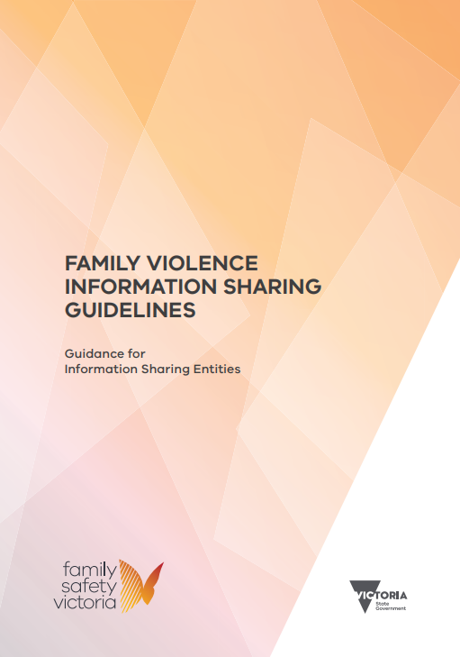
Family Violence Information Sharing Scheme
The Family Violence Information Sharing Scheme (FVISS), established under Part 5A of the Family Violence Protection Act 2008, enables authorised organisations and services to share information to facilitate the assessment and management of family violence risk to children and adults. It also facilitates keeping perpetrators of family violence in view and held accountable for their actions.
The MARAM Framework promotes consistency in language and understanding as well as setting out the responsibilities of different workforces in identifying, assessing and managing family violence risk across the family violence and broader service system​.

Slide 40
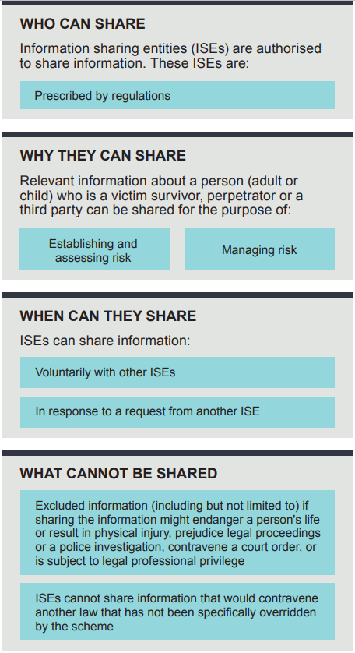
Family Violence Information Sharing Scheme
e.g. Victoria Police, Family Violence services, Alcohol and Other Drugs (AOD), hospitals, etc. Some ISEs are also prescribed as Risk Assessment Entities (RAEs)
Some examples:
A family violence therapeutic service is seeking information about alleged family violence perpetrated towards a family so that can provide the appropriate support.
Victoria Police is seeking Child Protection information relevant to an application for an IVO.
A school seeking information regarding a pupil's past family violence trauma to ensure appropriate supports for the child.
RAE requests information to identify, assess and manage a serious family violence risk.

Slide 41
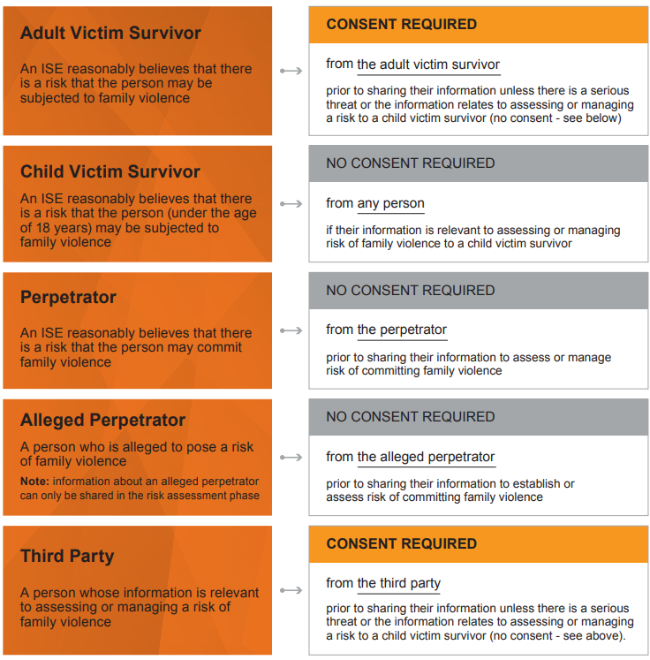
FVISS – Consent

Slide 42
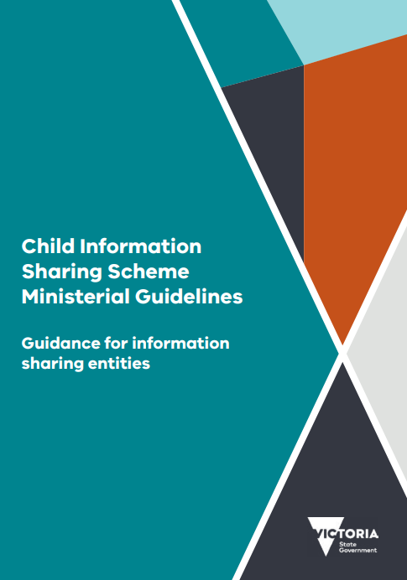
Child Information Sharing Scheme
The Child Information Sharing Scheme (CISS), established under Part 6A of the Child, Wellbeing and Safety Act 2005 enables authorised organisations and services to share information to promote the wellbeing or safety of children and facilitate services working together to:
identify needs and risks promote earlier and more effective intervention and integrated service provisions
improve outcomes for children and families.
All Victorian children and young people from 0-18 years of age are covered by the CISS.
For both schemes, while consent is not required, practitioners are still encouraged to seek and consider the views of the affected individual/s.

Slide 43
Child information Sharing Scheme
Some examples:
A hospital social worker requesting information for birth planning purposes relevant to an 'unborn' child where there were some concerns.
A school with concerns related to a child disclosing information regarding discipline in the home.
A school seeking information regarding departmental assessments to determine whether there is a need for greater support to the family for continued engagement of the child in their education.
An AOD practitioner with concerns regarding a mother's ongoing substance misuse.

Slide 44
Making a FVISS or CISS request to Child Protection
If you know there is an open case, you can contact the allocated child protection practitioner and discuss any request with the them directly.
Otherwise, authorised professionals from an ISE can request Child Protection information under the FVISS or CISS from the department using a secure webform – compliant requests for closed cases will receive a response in writing (usually within 7 business days). Requests for open cases will be referred to the allocated worker for a response. [https://informationsharingteam.powerappsportals.com/FVISSCISS]
General enquiries can be emailed to info.exchange@dffh.vic.gov.au.
Notes:
CISS requests to TOD – check with Renay

Slide 45
Appendices
Mandatory reporting and other legislative requirements
Resource links

Slide 46
Mandated reporters: Out of Home Care
An out of home care worker means a person employed (other than on a voluntary basis) by an out of home care service:
as a carer for children
as a provider of services to carers for children or the children in their care.
Out of home care worker includes:
foster care workers
kinship care workers
residential care workers
secure welfare service workers
adoption and permanent care workers
labour hire staff working in out of home care settings
workers supporting children in voluntary childcare arrangements
lead tenant workers
supervisors and managers of the above
targeted care package key workers
disability residential care workers
It does not include volunteer carers of children in foster or kinship care arrangements, lead tenant, adoption and permanent care.

Slide 47
Mandated reporters: Youth Justice
Youth justice workers that are mandated reporters include; youth justice officer, youth parole officer and youth justice custodial workers.
Youth Justice workers who are mandated reporters include:
A youth justice custodial worker employed or engaged in a remand centre, a youth residential centre or a youth justice centre, and whose duties include duties in relation to detainees in the custody of the Secretary
A youth justice officer includes the Secretary, and every honorary youth justice officer
A youth parole officer includes an honorary youth parole officer

Slide 48
Mandated reporters: Education and early childhood
All educators with post-secondary qualifications in the care, education or minding of children and employed or engaged in an education and care service or a children’s service
The proprietor or nominee (including the primary nominee) of a children’s service, or the approved provider or nominated supervisor of an education and care service
Education and early childhood work locations include:
children’s services
schools, teachers and principles
occasional care
sports and leisure services
education and care services
long day care
family day care
outside school hours care
vacation care
kindergartens
pre-schools

Slide 49
Mandated reporters: health and other professionals
A registered psychologist is a person registered (including those provisionally registered) under the Health Practitioner Regulation National Law to practice in the psychology profession (other than as a student, unless the student is a registered psychologist).
A school counsellor means a person employed or engaged (other than on a voluntary basis) to provide direct support to school students, at or directly connected with a school, for mental, emotional or psychological wellbeing.
Examples of health practitioners include:
Doctors
Nurses
Registered teachers
Registered psychologists
Speech pathologists
Chaplains (including religious ministers)

Slide 50
Reporting requirements
 | Who must report | What must be reported | Report to | Age of child
Mandatory reporting | Mandatory reporters s.182 CYFA 2005 | Child physical injury and sexual abuse, actual or likely, parents have not protected or are unlikely to protect | Child Protection | Under 17
Reportable conduct | Head of an organisation Child Wellbeing and Safety Act 2005 | Child abuse and neglect by a worker or volunteer | Commission for Children and Young People | Under 18
Failure to protect | Head of an organisation Crimes Act 1958 Sec 490 | Risk of sexual abuse by adult associated with the organisation | Police | Under 18
Failure to disclose | All adults Crimes Amendment (Protection of Children) Act 2014 | Child sexual abuse by an adult | Police | Under 16

Slide 51
What is a failure to protect?
Applies to people within organisations:
if they hold a position of authority
within a relevant organisation that works with children
they know of a substantial risk another adult associated with the organisation may commit a sex offence against a child under 16 within the organisation’s care
they have the power or responsibility to remove or reduce that risk
but they negligently fail to do so
Relevant organisations include but are not limited to:
churches
religious bodies
education and care services (e.g. childcare centres, family day care, kindergartens and outside school hours care)
licensed children's services such as occasional care services
schools and other educational institutions
organisations providing accommodation to children and young people, such as boarding schools and student hostels
out-of-home care services
community service organisations providing services for children
hospitals and other health services
government agencies or departments providing services for children
municipal councils (for example those that deliver Maternal and Child Health services)
sporting groups
youth organisations
charities and benevolent organisations providing services for children

Slide 52
What is a failure to disclose?
The law states that all adults must report to police when there is:
any reasonable belief that a sexual offence has been committed, by another adult (over 18) against a child under the age of 16
unless there is a reasonable excuse, or an exemption applies
Failure to disclose does not replace mandatory reporting obligations

Slide 53
Resources
Useful DFFH Links
Identifying abuse
Identify signs of child abuse | Victorian Government
https://www.vic.gov.au/child-protection-early-childhood-protect/identify-signs-child-abuse#neglect
Reporting abuse
https://services.dffh.vic.gov.au/reporting-child-abuse
https://providers.dffh.vic.gov.au/making-report-child-protection
Mandatory reporting
https://providers.dffh.vic.gov.au/mandatory-reporting
The Orange Door
https://www.orangedoor.vic.gov.au/
https://www.orangedoor.vic.gov.au/what-is-family-violence
https://www.orangedoor.vic.gov.au/caring-for-children
The Child Protection Manual
www.cpmanual.vic.gov.au
Family Violence
Family Violence Information Sharing Scheme | Victorian Government (www.vic.gov.au)
https://www.vic.gov.au/family-violence-information-sharing-scheme
MARAM Practice Guidance
https://www.vic.gov.au/maram-practice-guides-and-resources
MARAM and Information Sharing Training
https://www.vic.gov.au/training-for-information-sharing-and-maram

